Slide 1
Conditional Statements
Notes:
https://www.excel-easy.com/vba/create-a-macro.html

Slide 2
Table of Contents
If Then Statement
Else statement
Logical statements
Case Structure

Slide 3
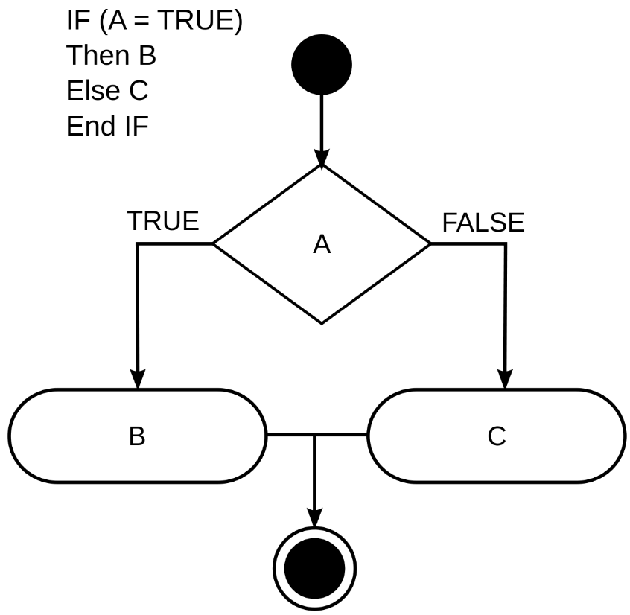
If Then Statement
Use the If Then statement in Excel VBA to execute code lines if a specific condition is met.

Slide 4
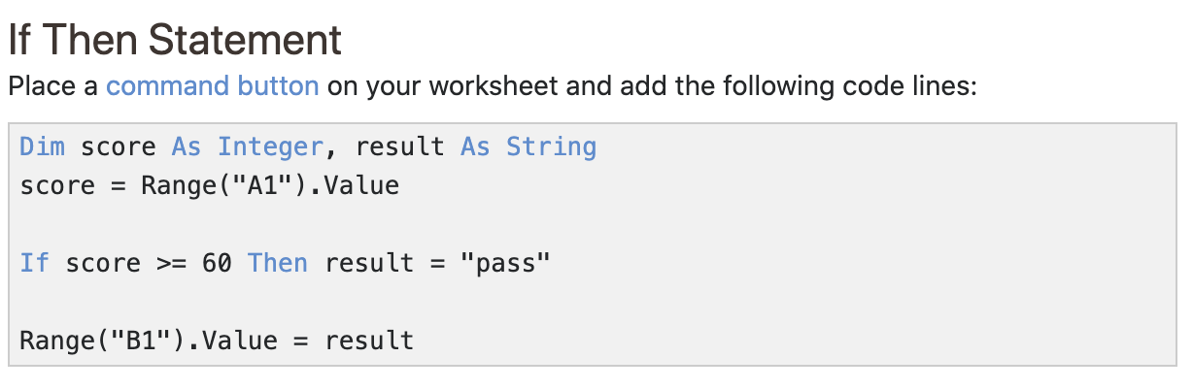
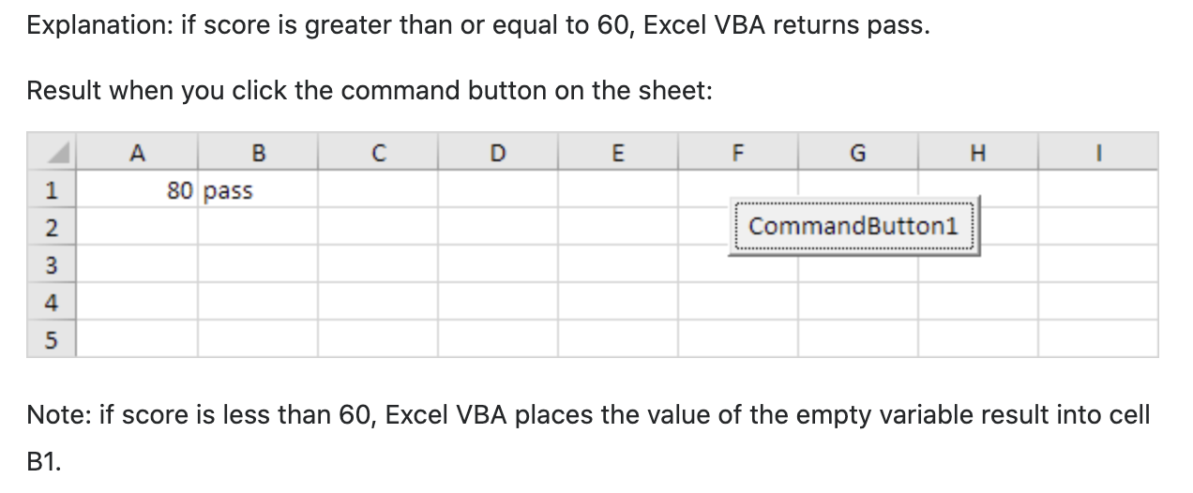
If Then Statement

Slide 5
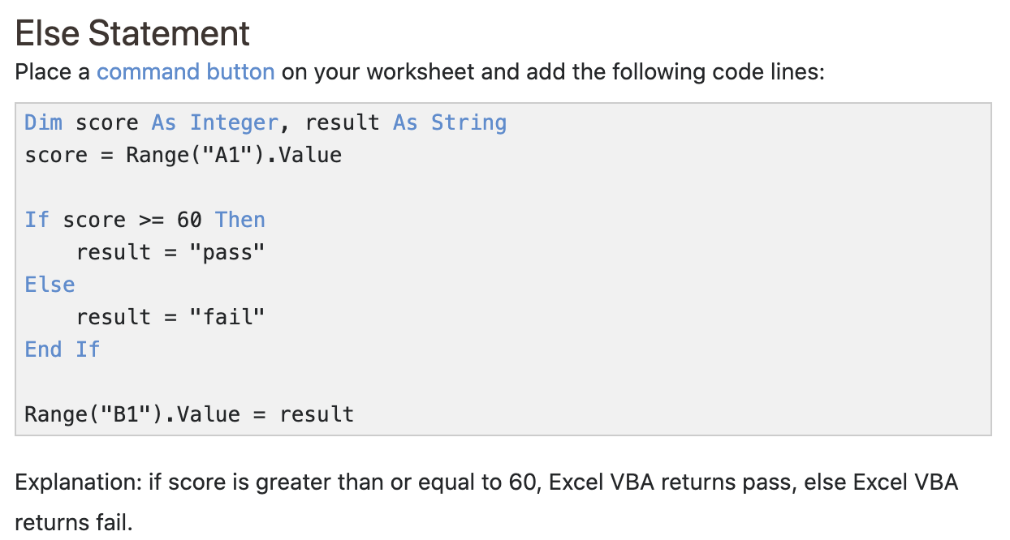
Else statement

Slide 6
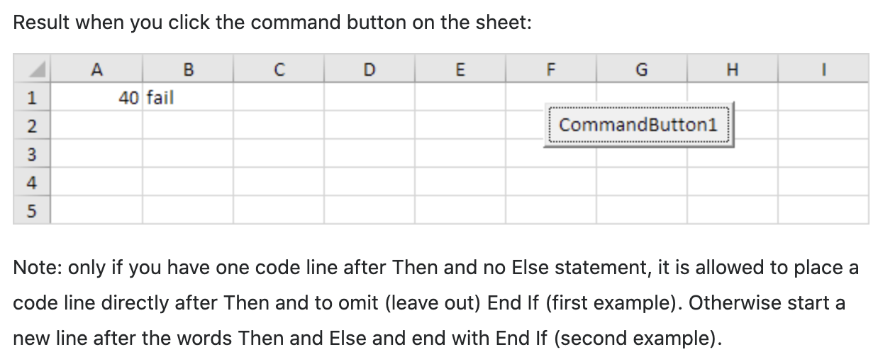
Else statement

Slide 7
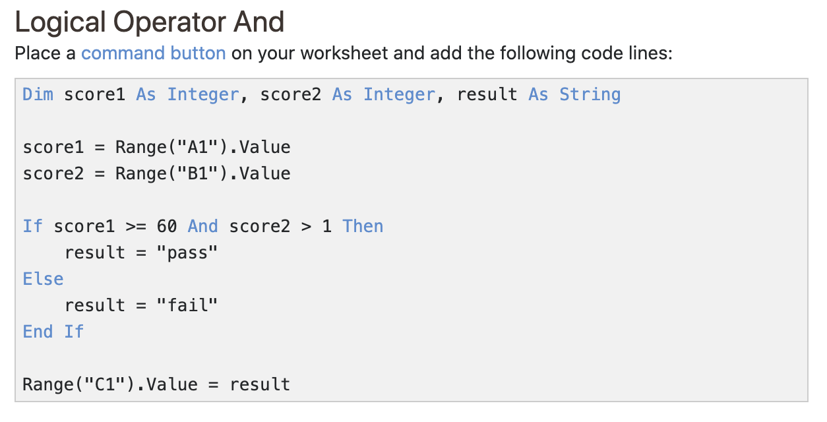
Logical statements
The three most used logical operators in Excel VBA are: And, Or and Not. As always, we will use easy examples to make things more clear.

Slide 8
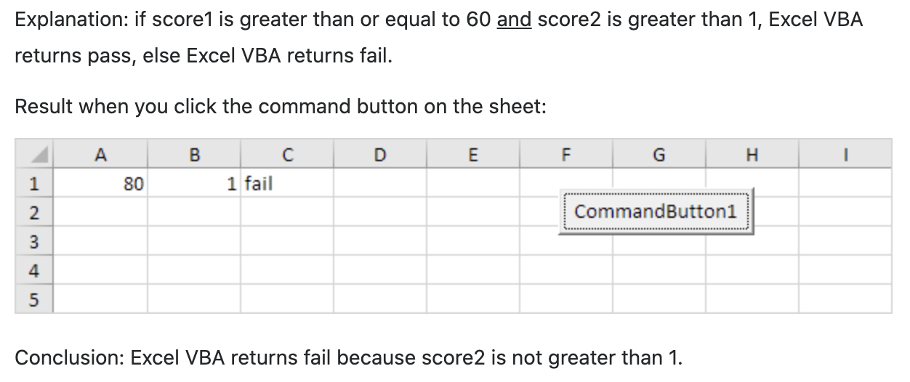
Logical statements

Slide 9
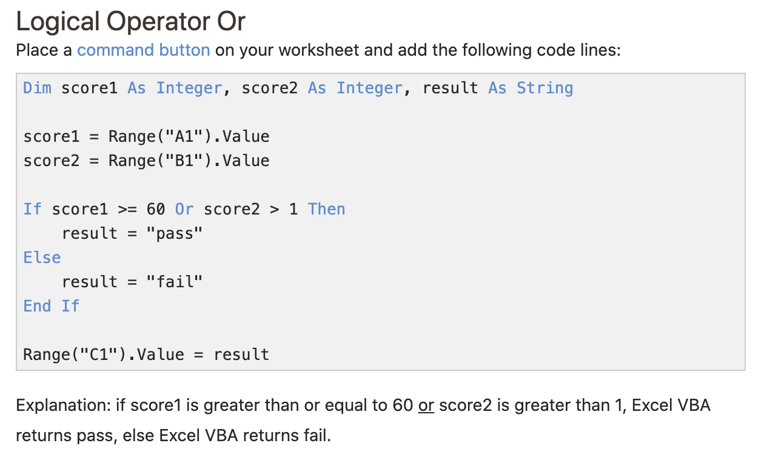
Logical statements

Slide 10
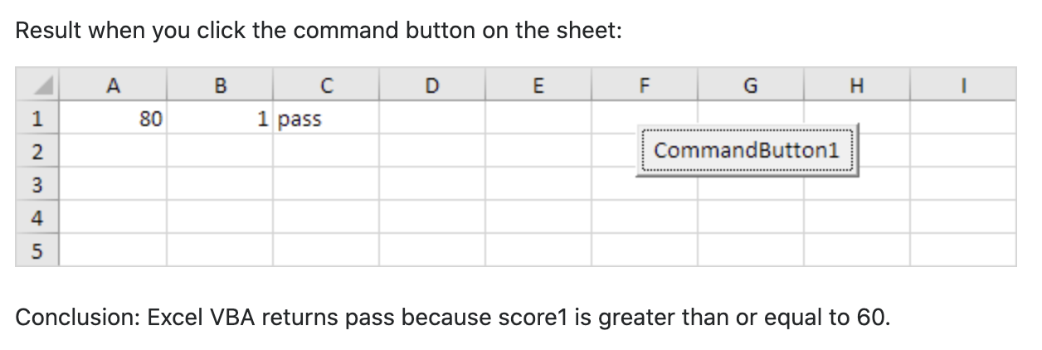
Logical statements

Slide 11
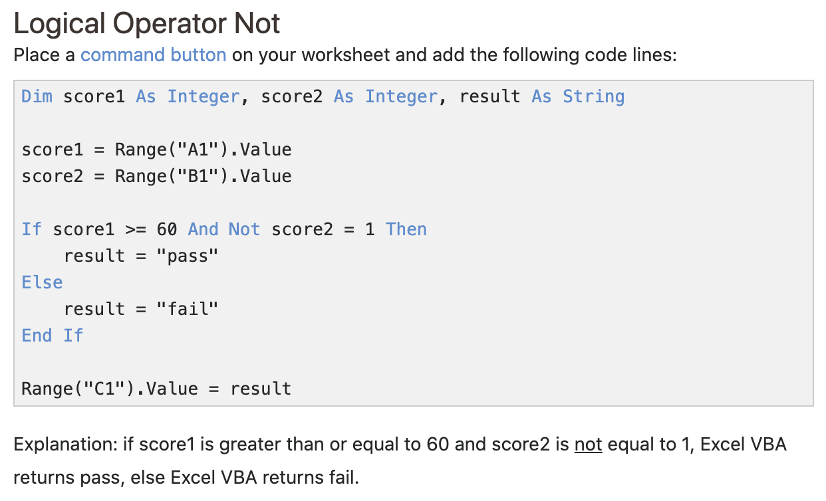
Logical statements

Slide 12
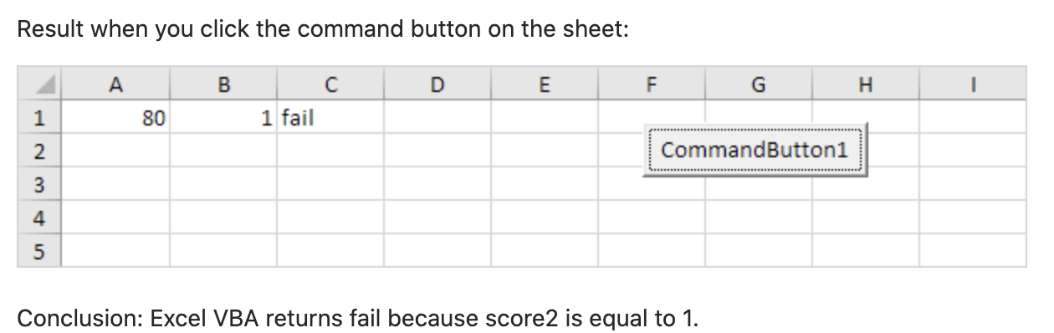
Logical statements

Slide 13
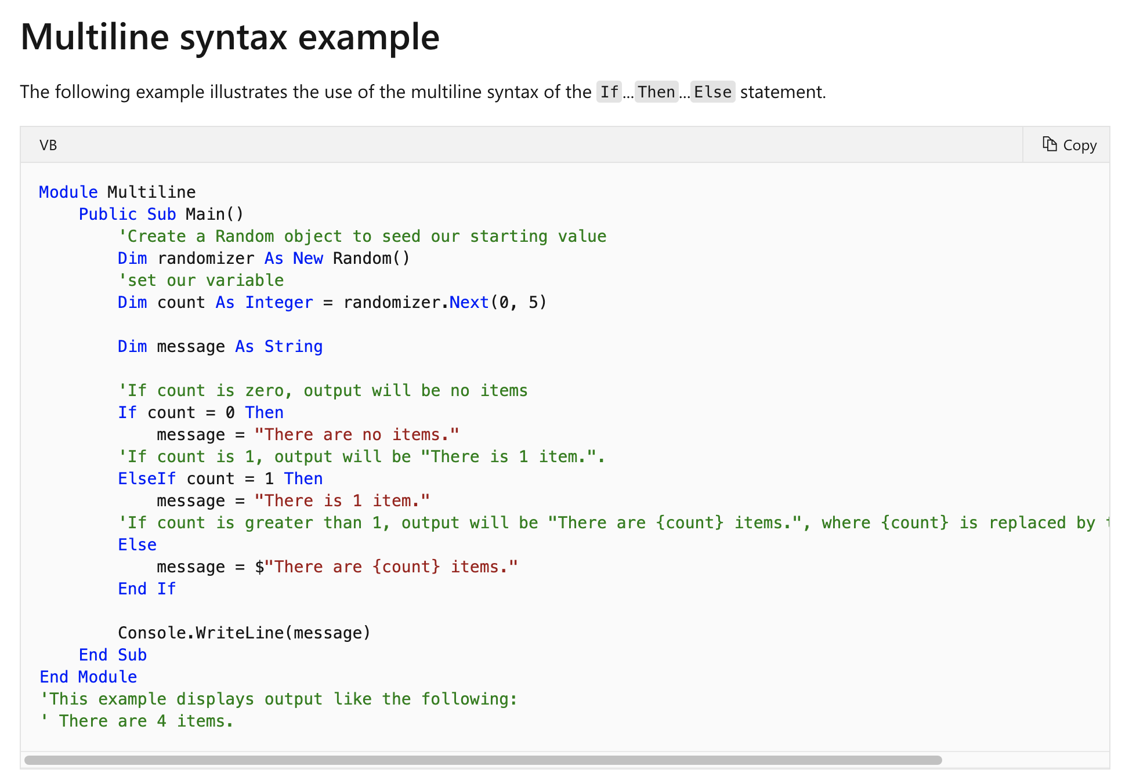
Logical statements
Understanding how ELSEIF works in visual basics

Slide 14
Logical statements
We will go through an example with ElseIf from the previous example shown earlier.

Slide 15
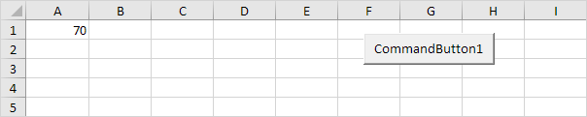
Case Structure
Instead of multiple If Then statements in Excel VBA, you can use the Select Case structure.

Slide 16
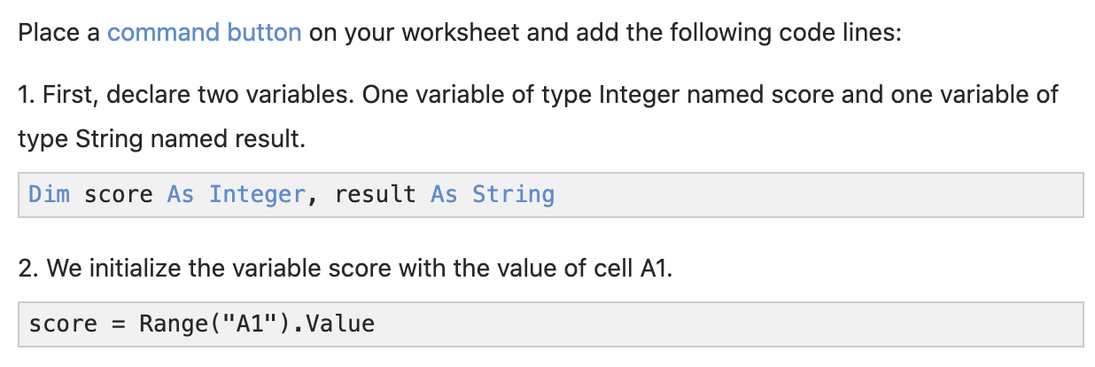
Case Structure
Instead of multiple If Then statements in Excel VBA, you can use the Select Case structure.

Slide 17
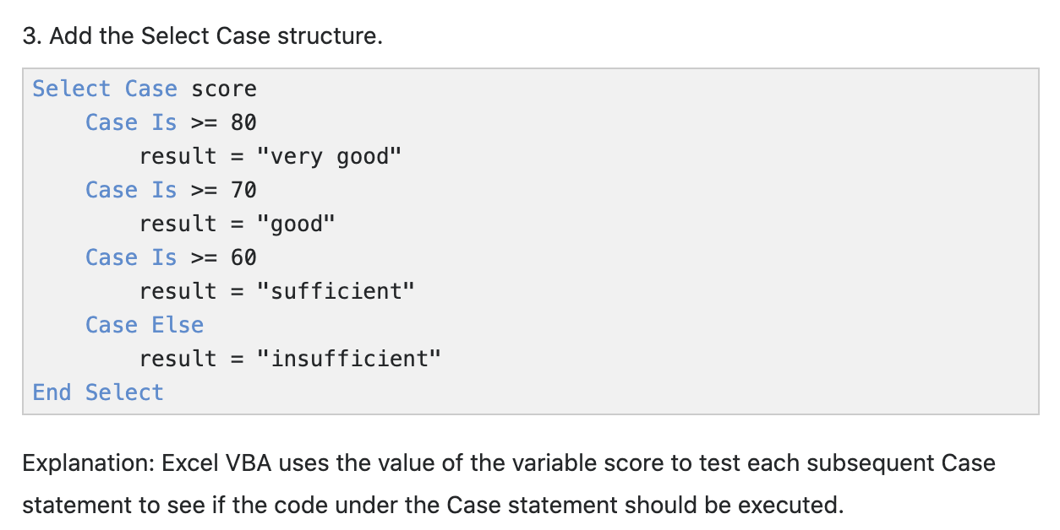
Case Structure

Slide 18
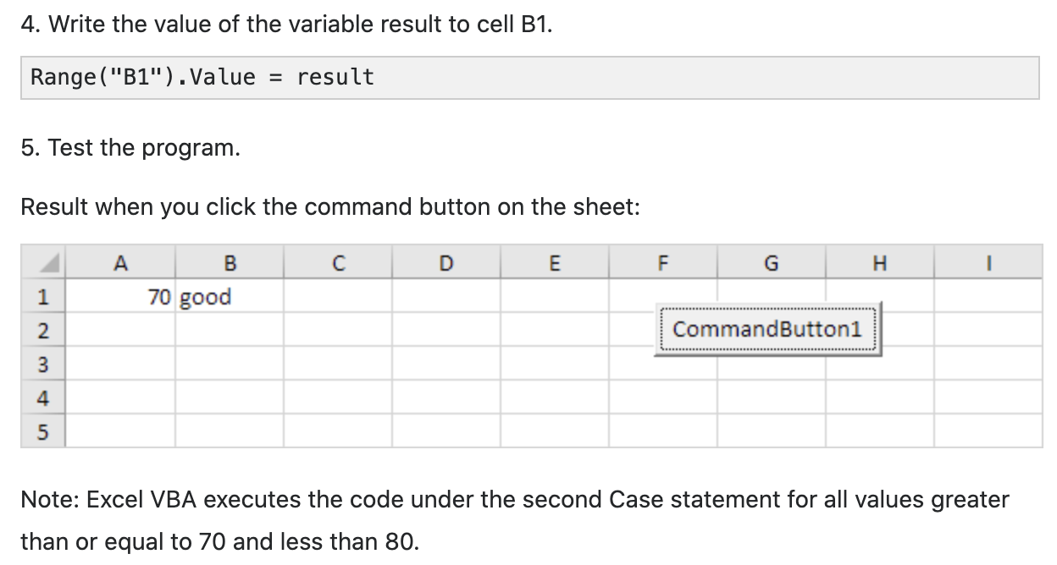
Case Structure

Slide 19
Exercise
Taxable Income | Tax on this income
0 – 10 000 | 0
10 001 – 20 000 | 1st 20,000 – should be charged 2%
20 001 - 30 000 | 1st 20,000 – should be charged 2% Next 10,000 – should be charged 3%
30 001 – 40 000 | 1st 20,000 – should be charged 2% Next 10,000 – should be charged 3% next 10,000 – should be charged 4%
40, 001 >= | 1st 20,000 – should be charged 2% Next 10,000 – should be charged 3% next 10,000 – should be charged 4% Balances above 40,000, should be charged 5%

Slide 20
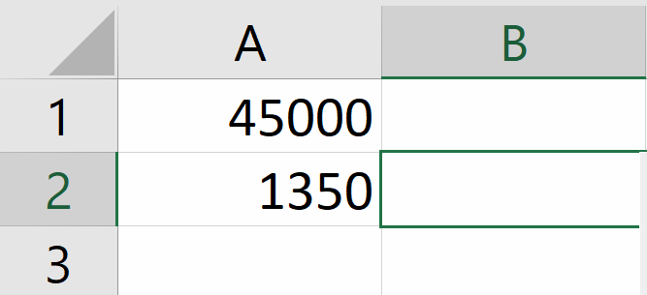
Exercise
Input the value in Cell “A1”
We will use Cell “A1” to read the value and compute from there
We will output the result in Cell “A2”

